Slide 1
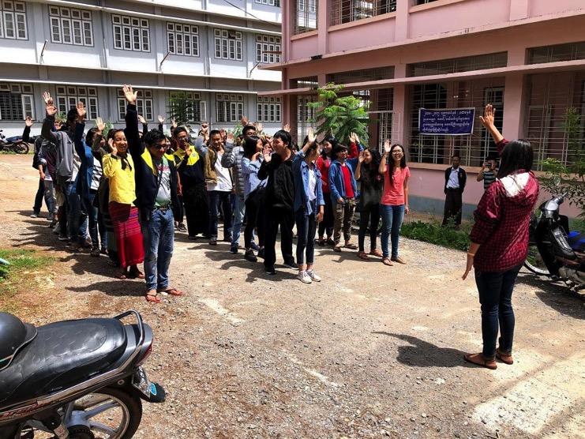
Collaboration to create projects for your community: Lessons from Myanmar and Nepal
BRITANE HUBBARD, MISSOURI WESTERN STATE UNIVERSITY
DAVID TUSHAUS, MISSOURI WESTERN STATE UNIVERSITY
NIRMAL UPRETI, FORUM FOR NATION BUILDING NEPAL
SETH FRYE, MISSOURI WESTERN STATE UNIVERSITY

Slide 2
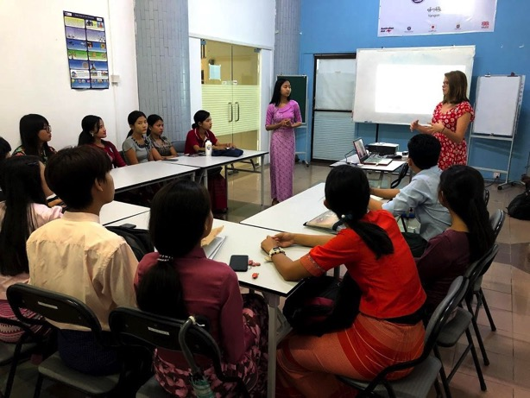
Our International Collaborations:
Difficulties
Needs Picture
Outcomes
Who, What, When, Where & How?
Success
Goals
Notes:
-Everyone on this panel was a part of an international collaboration to make these projects possible
-Talk about the formation: Chrissy, Mallory & I, the ongoing data collected by Nirmal, now Seth
-Nepal: We never actually had the opportunity to visit, how did we collaborate? Google.
-Myanmar: We had the opportunity to visit but also had students at home working on the projects. Collab between MWSU, BABSEACLE, Taunggyi Univ.
-Well defined project outcomes (Such as this presentation)
-Point out the picture, lack of resources and how we adapted to use phones.

Slide 3
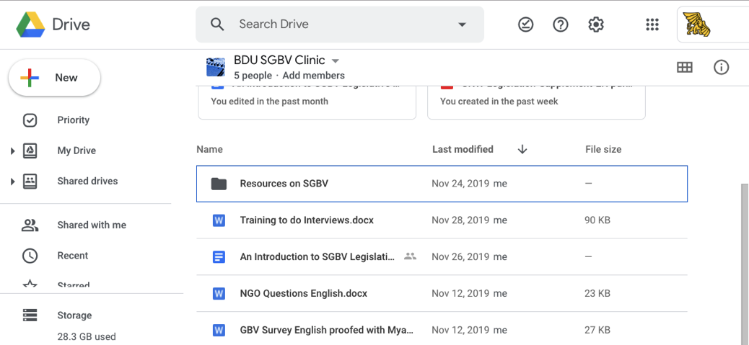
Global Community Collaborations: Bahir Dar University Law School, Ethiopia
Legislative Advocacy
Research SGBV Issues
Research changes in the law that could protect women in your country
Draft a legislative proposal
Advocate for the legislative proposal in print, media, etc.

Slide 4
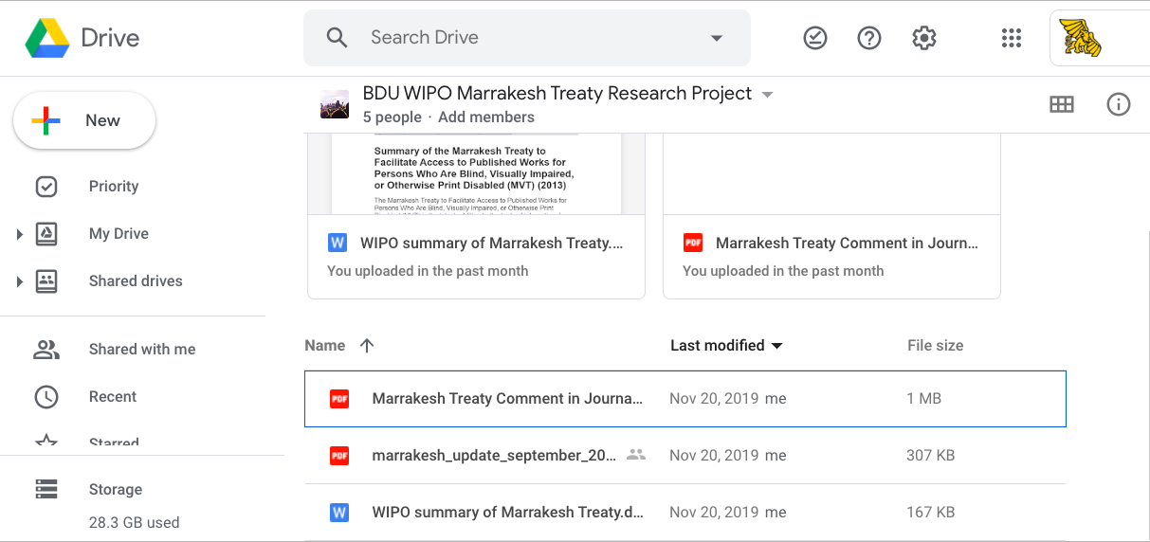
Global Community Collaborations: Bahir Dar University Law School, Ethiopia
Legislative Advocacy
Research Marrakesh Treaty
Research changes in the law that could adopt and implement this treaty
Draft a proposal to adopt the treaty and/or implement it
Advocate for the proposal in print, media, etc.

Slide 5
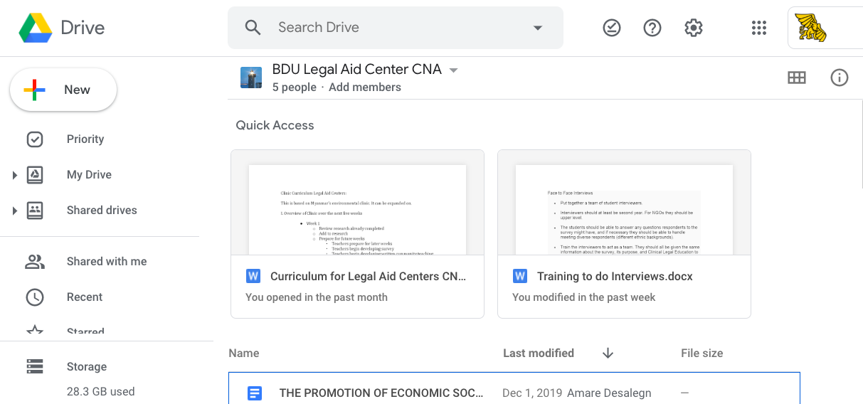
Global Community Collaborations: Bahir Dar University Law School, Ethiopia
Community Needs Assessments
Do a legislative review to learn more about
Problems in the community
Legal solutions to the problem your law school can address
Draft survey questions
Do focus groups in the community
Get IRB approval
Conduct surveys and code data

Slide 6
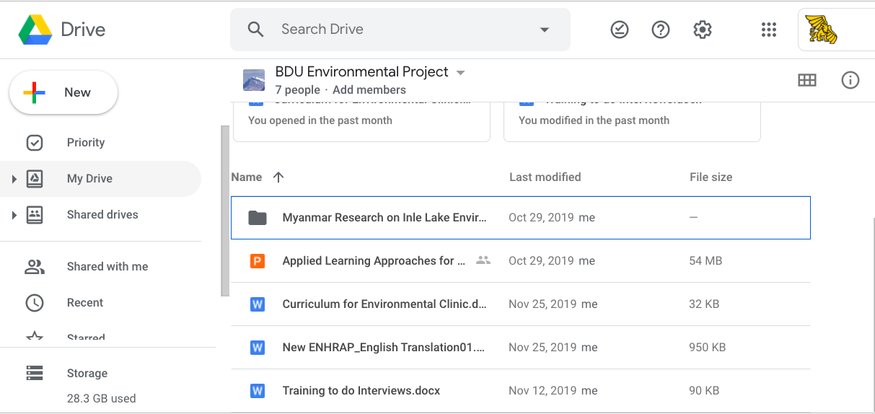
Global Community Collaborations: Bahir Dar University Law School, Ethiopia
CNAs have many purposes
Hand out educational material after conducting the survey as a community teaching project.
2. Design projects based on results.
3. Academic presentations & publications.
4. Support grant requests.

Slide 7
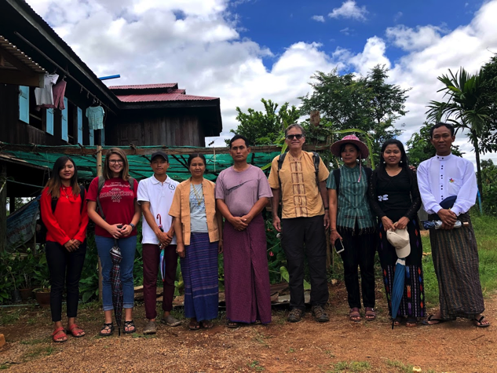
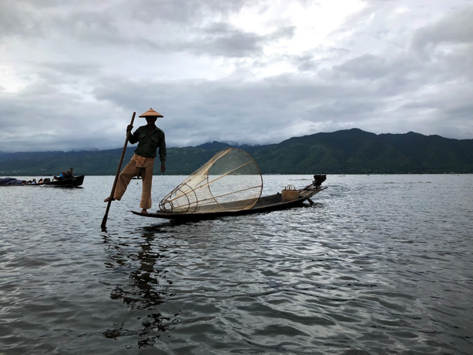
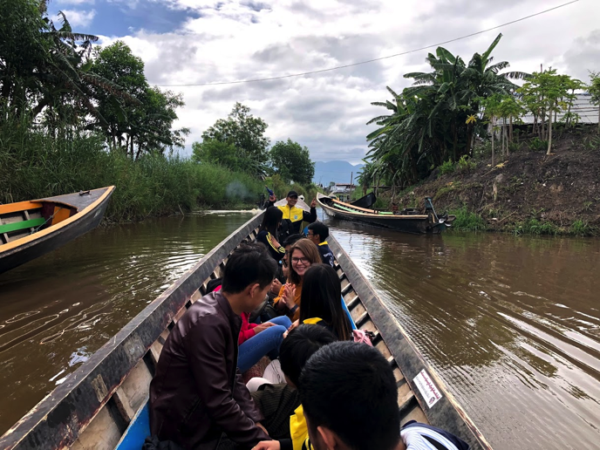
Environmental Justice Clinic
Our Collaboration Experience
Notes:
-P1, tangent on Myanmar education system (if time), environmental champion, lots of interest
-Collaboration with village leaders, difficulties (language, people told us no)

Slide 8
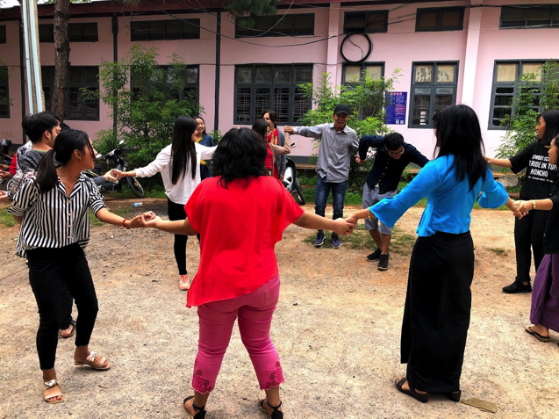
Interactive Activity:
Form small groups-We will assign you if needed :)
Collaborate and discuss ways in which your group could create a special project.
Things to keep in mind:community needs, issues, how the issue can be addressed, who will be conducting the project, and how could grants or funding help.
We will ask you to share with the rest of the audience.
Please be as specific as you can.

Slide 9
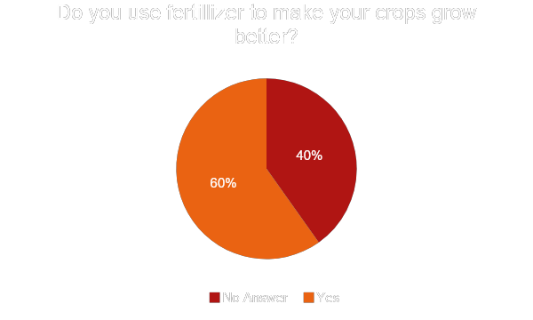
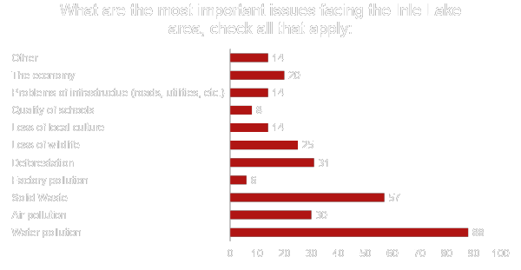
What we found:
Notes:
Fix the bottom pie chart

Slide 10
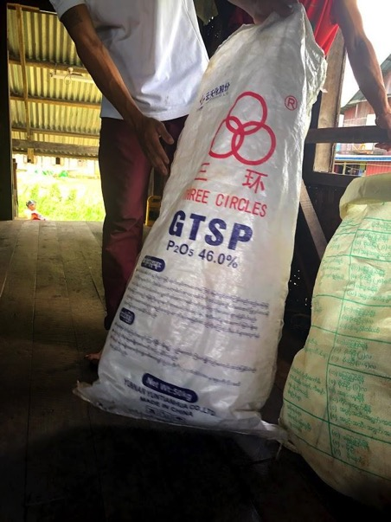

Slide 11
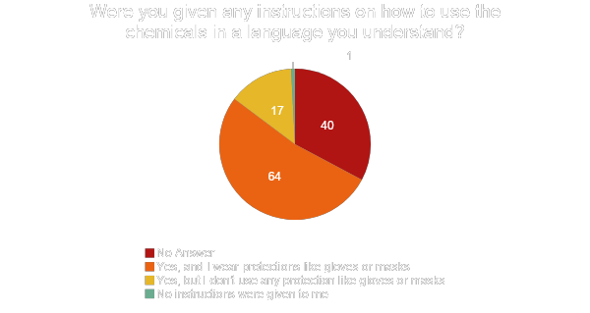

Slide 12
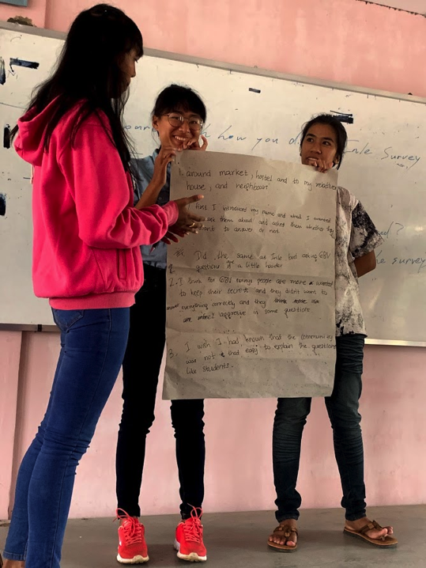
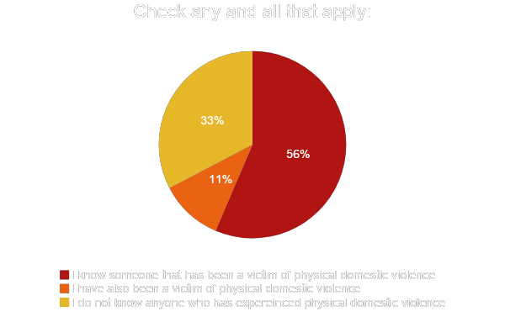
Sexual & Gender Based Violence Clinic
Our Collaborative Experience
Notes:
-Very different: Not as accepting of international views

Slide 15
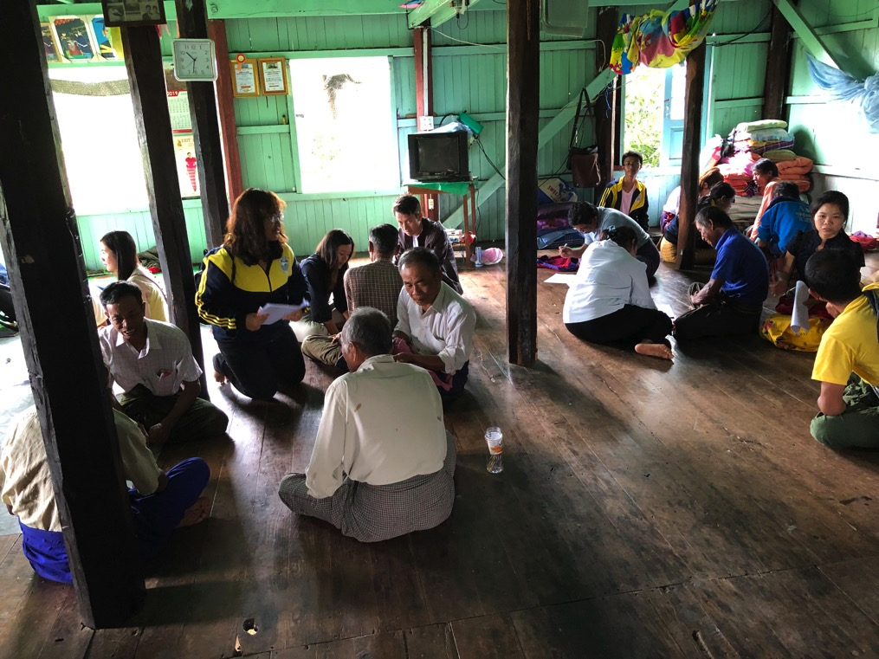
Mobile Legal Clinic Overview
Assessments:
Necessary to guide the clinic
Gives avenue to preliminary areas of research/aid
Community Connections
Uses:
Replacing legal documents,
Loss of house or job,
Land disputes,
Government aid,
Or domestic violence
Notes:
Talk about Community Connections

Slide 16
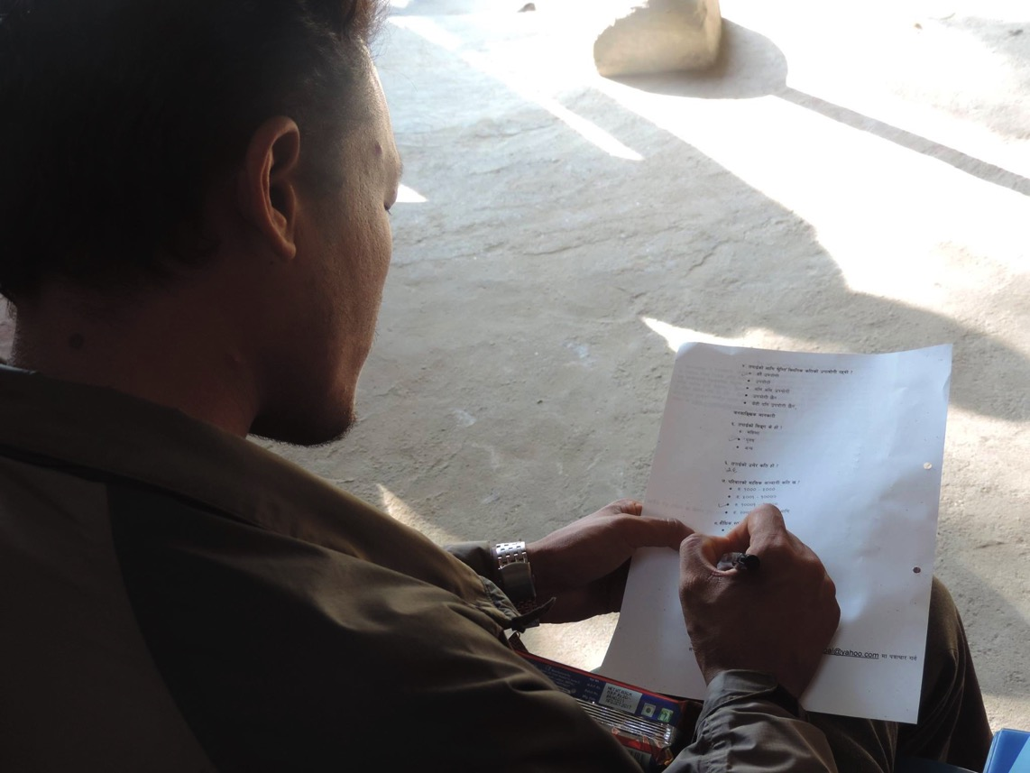
Feedback from surveys and reaching out to other organizations & Government to create relationships and continue meeting the needs of the community.

Slide 17
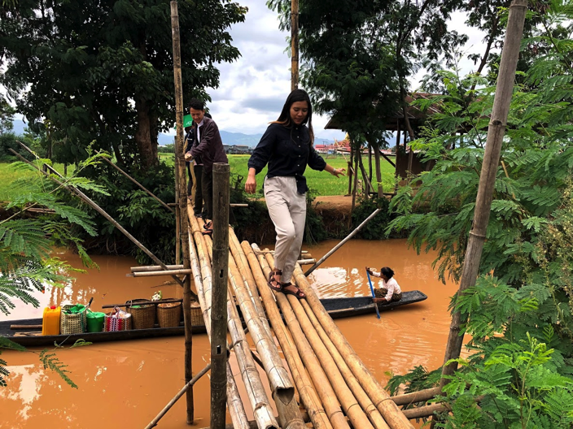
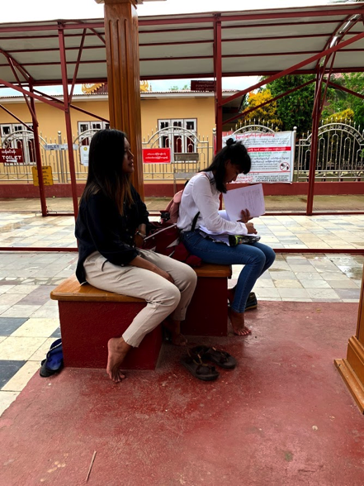
What we can do with this information:
Create community education projects.
1
Share with local NGO’s to assist in meeting needs.
2
Develop curriculum to educate students on issues.
3
Apply for grants
4

